Slide 1

Case Study ORAN
Presented By : ASHIQ PATHAN

Slide 2

Agenda
01 | Project Background
02 | ORAN Strategy
03 | Benefits vs. Challenges
04 | Budget
05 | Project plan & Expert team
06 | Recommendation

Slide 3
Omantel is the largest mobile operator in Oman
Case Study
Background
Omantel currently offers advanced mobile communication services and operates a single RAN solution.
Omantel has renewed and expanded its agreement for next five years.
Ericsson provides support and managed E2E multivendor operations.
Field support and maintenance for 2G,3G,4G and 5G access.
Network Functions Virtualization (NFVI) solutions, provide the highest levels of operation, and maintenance capabilities.
Automation platforms to allow Omantel to increase operational network efficiency and further enhance customer experiences for its subscribers.
Mobile users : 3 Mio. (2G/3G/4G, 5G just launched).
Goal
Discuss about the development of ORAN strategy and RAN vendor selection for Omantel.
Deploy of ORAN and when and how this will impact managed services.
Budgets and cost estimation to the 5G rollout and the network modernization.
Project outline and key experts.

Slide 4
Open RAN
An Open Radio Access Network (ORAN) is a nonproprietary version of the Radio Access Network (RAN) system that allows interoperation between cellular network equipment provided by different vendors.
Open RAN enables programmable, intelligent, disaggregated, virtualized, and interoperable functions.
In 5G instead of BBU, we have central unit or CU and distributed unit or DU. Fronthaul and backhaul remains same. Midhaul has been introduced to connect CU-DU.
Remote units (RUs)
Distributed units (DUs)
Centralized units (CUs)
Many of which can be virtualized or containerized. The interfaces between these new components are open and interoperable.
4G/5G Core Network
Backhaul
BBU
CU
Midhaul
DU
Fronthaul
RRU
RU

Slide 5
ORAN Deployment Model
New vendor B OpenRAN HW can work out of the box with Vendor V1 SW
Existing Vendor HW A could be swapped out easily when required with a new Vendor HW B or C
SP/MNO could replace the OpenRAN SW as easily as the did the HW. Existing HW continues to work with the new SW from Vendor V2
Vendor V1 supplying virtualized SW & Vendor A is supplying RAN HW
service
service
service
service
service
service
service
service
service
service
service
service
service
service
service
service
service
service
service
service
Services
Core Network
Core Network
Core Network
Core Network
Core Network
Transport Network
Transport Network
Transport Network
Transport Network
Transport Network
OpenRAN Software
V1
V1
V1
V2
COTS Servers
COTS Servers
COTS Servers
COTS Servers
OpenRAN HW from any Vendor
Vendor A
Vendor A
Vendor A
Vendor A
Vendor A
Vendor A
Vendor A
Vendor B
Vendor B
Vendor A
Vendor A
Vendor A
Vendor B
Vendor B
Vendor C
Vendor A
Vendor A
Vendor B
Vendor B
Vendor C

Slide 6

Why ORAN?
Intelligent and
programmable
networks
Lower total cost of ownership
The Goal is for any HW/SW to interoperate both seamlessly and securely regardless of its originating vendor.
More innovation and more options for the operators.
Artificial Intelligence can be introduced via the RIC (Ran Intelligent Controller) to optimize the network.
ORAN
Faster time to market
Agility of
innovation
Automation &
manageability
Data center economics
to radio network
Vendor diversity
Notes:
Global mobile operators are pushing for open, intelligent, virtualized, and fully interoperable RAN solutions.
RAN Intelligent Controller (RIC) is a new optional virtualized 5G optimization technology that adds programmability to an existing or new RAN.
The RIC platform provides functions and interfaces that boost optimization through policy-driven closed loop automation and faster, more flexible service deployments, as well as programmability with AI/ML technologies within the RAN.
It may take three to five years for open RAN technology to fully mature, but adoption should accelerate rapidly, due to the open design and to the economic and competitive forces driving 5G market growth. The open RAN market has the potential to grow substantially, from 1% of the total RAN market today to 10% by 2025

Slide 7
Benefits vs. Challenges
Case Study
Benefits
Challenges
Impact in managed services: Open RAN features and vendor flexibility.
Cost savings: virtualized network, with containerized components – true scalability and cost management.
Vendor choice: contractual flexibility to balance features, cost, and adjust future decisions; opening and standardizing interfaces gives a greater choice of vendor solutions.
Deploying O-RAN gives providers a clear path towards fully programmable, intelligent, and multi-vendor RAN with the help of a RAN Intelligent Controller (RIC).
Performance: comparing the performance of very mature solutions from vendors who deployed very early, against the very latest ORAN vendors solution is not very fair! There is still a long way to go to reach good maturity for ORAN solutions
Real interoperability: Actually, one of the big issues of the ORAN nowadays is the full interoperability between OS, SW, HW and orchestrators vendors. Today, not all vendors are compatible for the time being, and that’s why, before deployment, CSPs still need to do interoperability testing of the solution.
Infrastructure readiness: In ORAN the fronthaul interface is mostly conveying real time data and signaling. That’s why we need to adopt very strict performance requirements between sites and EDGE clouds or Central clouds according to the selected split options.
Notes:
communication service providers (CSPs)

Slide 8

Budget/ cost estimation
Technical Cost → 60%
Hardware
Software
Operational cost
Non-Technical Cost → 40%
Management cost
Training personnel

Slide 9
Project plan
Case Study
Phase 1
Study and analysis of current scenario and identify, gather require equipment
Phase 1: Study and analysis of current scenario and identify, gather require equipment.
Phase 2 : Indoor test/small testbed trial
Phase 3: Deployment /rollout in small area and expend slowly.
Phase 3
Deployment /rollout in small area and expend slowly.
Phase 1
Phase 2
3-4 Months
5-6 Weeks
6-12 Months
Phase 3
Phase 2
Indoor test/small testbed trial

Slide 10
Deliverable
Case Study
Work Package
ORAN expert team
ORAN expert
Project manager
Radio access network engineer
Cost management expert
Phase 1 deliverable
Vendor assessment & selection, Infrastructure assessment, Cost estimation, Knowledge evaluation
HW & SW procurement, Testing support, Vendor communication, ORAN house setup, Training
Rollout support
Phase 2 deliverable
Phase 3 deliverable

Slide 11
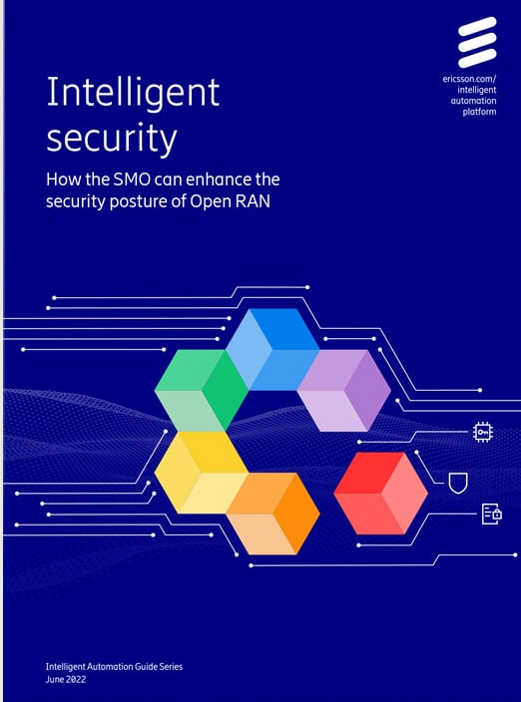
Recommendation
Case Study
Use Ericsson infrastructure as the agreement is renewed recently.
In addition to that, Ericsson also provides Intelligent Automation Platform, it allows to deploy Open RAN to reduce network complexity and operational costs.
It allows Third party RAN HW or developer to run on the platform and accesses data and controls radio access network elements.
By using existing infrastructure Omantel will have faster deployment of ORAN.
Contractual flexibility of using new vendor as a result cost can be minimized .
Every vendor offering interoperate with other products and enable service providers to benefit from cloud scale economic and service agility.
Consulting Fee: 70,000 Euro

Slide 12

02
Backup slide
Figure: visualcomponent.com

Slide 13
Evolution to 5G OpenRAN
Same approach to multiple vendors being able to interoperate with each other continues
In 5G to the open RAN approach.
DU and CU vendor do not have to be same and DU vendors should be
able to work with same RU vendors because of the open specified interfaces.
service
service
service
service
service
4G/5G Core Network
Services
Core Network
Core Network
Transport Network
Transport Network
Backhaul
V2
OpenRAN CU
BBU
CU
COTS Servers
Midhaul
DU
V3
V2
V4
OpenRAN DU
Fronthaul
In 5G instead of BBU, we have central unit or CU and distributed unit or DU. Fronthaul and backhaul remains same. Midhaul has been introduced to connect CU-DU.
COTS
COTS
COTS
RRU
RU
Vendor A
Vendor A
Vendor B
Vendor B
Vendor C
OpenRAN RRU

Slide 14
Project Plane
Phase 1
Phase 1: Study and analysis of current scenario and identify, gather require equipment.
Phase 2 : indoor test/small testbed Trial
Phase 3: Deployment /rollout in small area and expend slowly.
Phase 2
Phase 3
Phase 3
1-3 Years
Phase 2
Phase 1
2-3 Months
5-6 weeks

Slide 15

Benefits vs. Challenges
increase vendor diversity and avoid lock-in.
This happens when service providers are “locked in” using a single vendor to supply their equipment and software because switching suppliers isn’t straightforward. Now, service providers want to move away from single-vendor solutions towards open, multi-vendor networks with enhanced control and flexibility.
Deploying O-RAN gives providers a clear path towards fully programmable, intelligent, and multi-vendor RAN with the help of a RAN Intelligent Controller (RIC).
A RAN Intelligent Controller (RIC) is a software-defined component of the Open RAN architecture that controls and optimizes RAN functions. The RIC is an important part of Open RAN disaggregation, bringing multi-vendor interoperability, intelligence, agility, and programmability to radio access networks. It enables the onboarding of third-party applications that automate and optimize RAN operations at scale while supporting innovative use cases that lower mobile operators’ total cost of ownership (TCO) and enhance customers’ quality of experience (QoE).
Benefits
“Performance: For sure, comparing the performance of very mature solutions from vendors who deployed very early, against the very latest ORAN vendors solution is not very fair! There is still a long way to go to reach good maturity for ORAN solutions
Real interoperability: Actually, one of the big issues of the ORAN nowadays is the full interoperability between OS, SW, HW and orchestrators vendors. Today, not all vendors are compatible for the time being, and that’s why, before deployment, CSPs still need to do IOT interoperability testing of the solution
Infrastructure readiness: In ORAN the fronthaul interface is mostly conveying real time data and signaling. That’s why we need to adopt very strict performance requirements between sites and EDGE clouds or Central clouds according to the selected split options.”
Challenges

Slide 16
01
Experts
Project Manager
02
ORAN expert
Project Manager
Project Organization
03
04
Radio Access Network engineer
Quality ensure
Supporting team
Cost Management expert

